Slide 1
Barack Obama vs. the Martians
A Lesson in Database Relationships

Slide 2






The Story (part 1)
Barack Obama assembled a
celebrity welcoming party to greet
a contingent from Mars, about to
land on Earth for the first time.
  Kim Kardashian
  Kanye West
  Lady Gaga
  Jimmy Fallon
  Justin Bieber
Two spaceships land:
The Command spaceship
  Piloted by Commander Gleep
  Accompanied by his son, Gleep Jr.
Welcome, friends from Mars!
The Hyperwarp cruiser
  Piloted by Gleep's wife, Gorka
  Accompanied by her bodyguard, Glorp

Slide 3




The Story (part 2)
Things do not go as planned.
Gleep exits his spaceship first and promptly
shoots Kim Kardashian,Kanye West and
Jimmy Fallon.
Gorka and Glorp emerge next.
Lady Gaga reveals herself to be an under-
cover Martian (was there any doubt?).
Gleep, Gorka, Glorp and Gaga point their
lasers at Obama and fire.
Not to be outdone, young
Gleep rushes out to shoot
Justin Bieber as he tries to
make a hasty get-away.
Welcome, friends from Mars!
Glorp
Gleep, Jr.
Gleep
Gorka

Slide 4
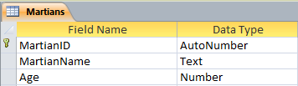
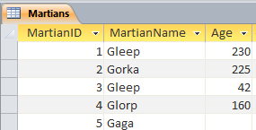
Building Tables
Design View
First we create the Martians table.
Note that since Gleep and his son have the same name. The names cannot uniquely identify a record.
Note that Access assigns a primary key automatically, called "ID" using an AutoNumber type to generate unique row numbers or record numbers.
However, since "ID" is not terribly descriptive, let's rename the column (field) to be "MartianID"
Datasheet View
Lady Gaga never reveals her age

Slide 5
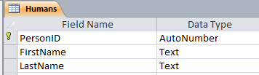

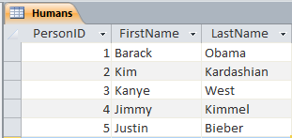
Determining Relationships
After we build the Humans table, we need to identify the relationships between Martians and Humans.
Each Martian can shoot many Humans. (Gleep shot 3 celebrities).
Each Human can be shot by many Martians. (Obama was shot by 4 Martians.)
Many to Many
Design View
Design View
Datasheet View
Datasheet View
Lady Gaga never reveals her age

Slide 6
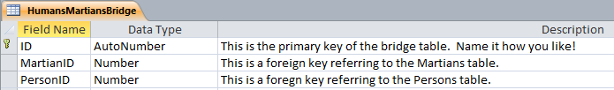
Designing Relationships
Many to many relationships require a bridging table or a linking table.

Slide 7
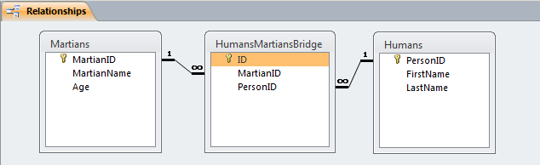
Building M:M Relationships in Access
Now we have fields in common that we can link together.
Primary key MartianID in the Martians table can link to
foreign key MartianID in the HumanMartiansBridge table.
Primary key PersonID in the Humans table can link to
foreign key PersonID in the HumanMartiansBridge table.
"Each MartianID can appear in the linking table many times."
"Each PersonID can appear in the linking table many times."

Slide 8
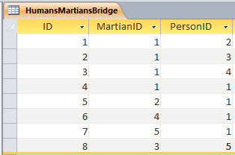
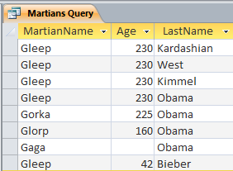
Using Relationships in a Query
After entering data into the bridging or linking table, we are then able to create a query that shows us who shot who.

Slide 9



More Relationships
Glorp
Gleep, Jr.
Gleep
Gorka
The Command Spaceship
The Hyperwarp Cruiser
Each Martian arrived on one spaceship.
Each Spaceship transported many Martians.
One to Many

Slide 10
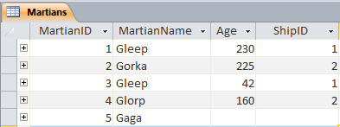

Building 1:m Relationships in Access
For a 1:m relationship, you do not need a linking table.
Instead, you need to add the primary key from one table as the foreign key from the other.
But which way?
This works! Note Gaga has no ship, but this is okay.
MartianID in Spaceships won't work.
Multiple values in field!
X

Slide 11
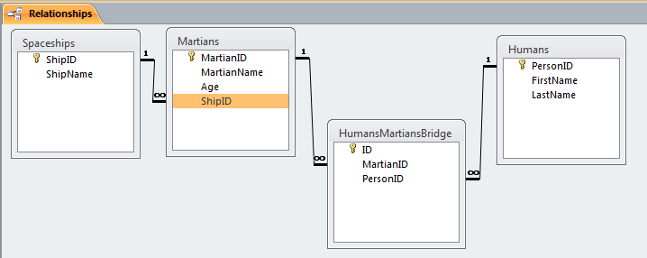
The Final Relationships

